Slide 1
Spremeni tabelo
Napiši metodo Krajsaj(t) ki iz vseh števil v dani tabeli celih števil pobriše vsa števila, deljiva s 3. Tako npr. iz tabele [1,3,2,33,112,12] nastane [1,2,112]. Metodo preveri v programu.

Slide 2

Ideja 1
public static void SpremeniTabelo(int[] tab)
{
int[] nova;
int prestej = 0;
foreach (int el in tab)
{
if (el % 3 != 0) prestej++;
}
nova = new int[prestej];
int kje = 0;
foreach (int el in tab)
{
if (el % 3 != 0) nova[kje++] = el;
}
tab = nova;
}
Bo delala?
int[] tabela1 =
new int[] { 121, 4, 2, 3, 5, 67, 89 };
SpremeniTabelo(tabela1);
foreach (int item in tabela1)
{
Console.WriteLine(item);
}

Slide 3
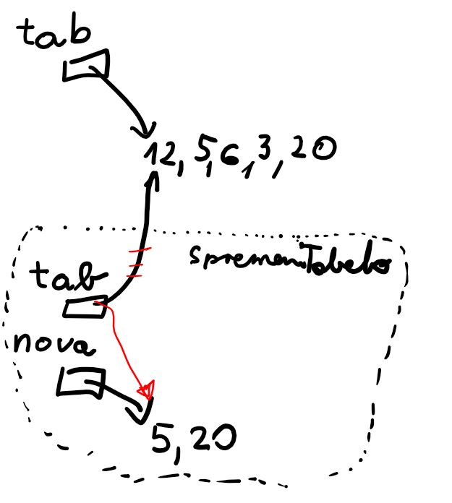
Zakaj ?

Slide 4
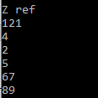
Ideja 2
Bo delala?
public static void SpremeniTabelo(ref int[] tab)
{
int[] nova;
int prestej = 0;
foreach (int el in tab)
{
if (el % 3 != 0) prestej++;
}
nova = new int[prestej];
int kje = 0;
foreach (int el in tab)
{
if (el % 3 != 0) nova[kje++] = el;
}
tab = nova;
}
int[] tabela1 =
new int[] { 121, 4, 2, 3, 5, 67, 89 };
SpremeniTabelo(ref tabela1);
foreach (int item in tabela1)
{
Console.WriteLine(item);
}

Slide 5
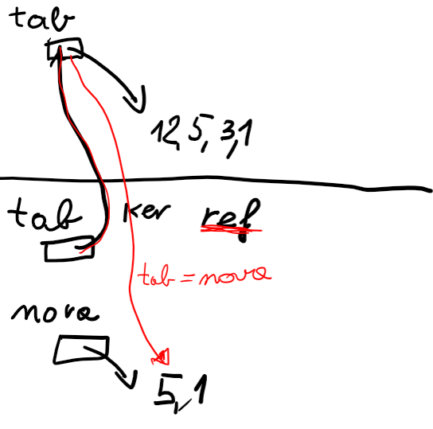
Zakaj?

