Slide 1
Čas. zahtevnost
zgledi

Slide 2
for i in range(n):
print(i)
# ---------------
x = 0
for i in range(n):
for j in range(1, n + 1):
x = x + i//j
# ---------------
v1 = 0
v2 = 0
for i in range(1, n):
v1 = v1 * i
for k in range(n):
for j in range(1, n + 1):
x = x + k//j
# ---------------
if n == 1:
print('Narobe: ')
else:
v = 0
for i in range(1, n):
v = v + i**3
n * c →
O(n)
c1 + n * (n * c2) →
O(n²)
c1 + n * c2 + (n * n * c3) →
O(n²)
c1 + c2 + (n – 1) * c3 →
O(n)

Slide 3
i = 1
while i <= n:
i = i * 2
print(i)
# ---------------------------
i = n
while i >= 1:
i = i // 2
print(i)
k * c →
O(log n)
2^{k} > n
log …
m * c →
O(log n)

Slide 4
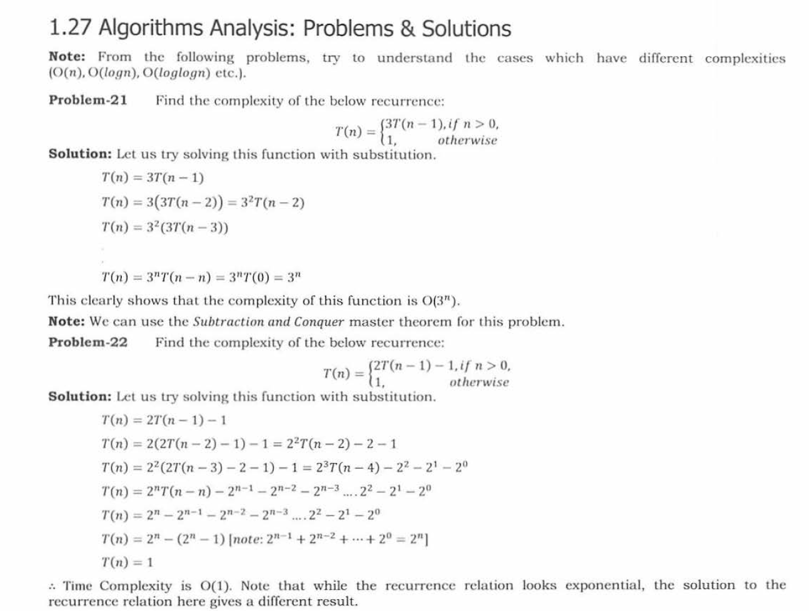
O(3^{n})

Slide 5
O(1)

Slide 6
i = s = 1
while s < n:
i += 1
s = s + i
print('*')
i = s = 1
while s < n:
i += 1
s = s + i # s ne narašča po 1!!
print('*')
k * c …O(k)
S
1 + 2 + 3 + … + k > n
k * (k + 1) / 2 > n
O(√n)
k * c …O(k)

