Slide 1
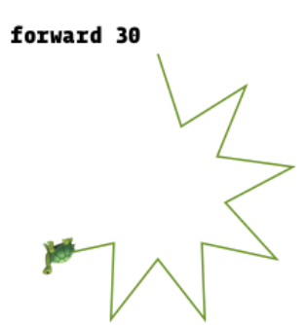
Želvja grafika
Osnovna ideja: https://www.wikiwand.com/en/Turtle_graphics

Slide 2
Želvja grafika
Python
  from turtle import *
  risar = Turtle()
  risar.forward(50)
Osnovni ukazi
  fd(100) ali forward(100)
  left(90) ali lt(90)
  penup() ali pu()
  pendown() ali pd()

Slide 3
DEMO
Nekaj slik z želvjo grafiko (kvadrat, enakostranični trikotnik, …)

Slide 4
Gre pa tudi bolj kompleksno
TurtleDemo
(priloženo v nametsitev Pythona v Lib)

Slide 5
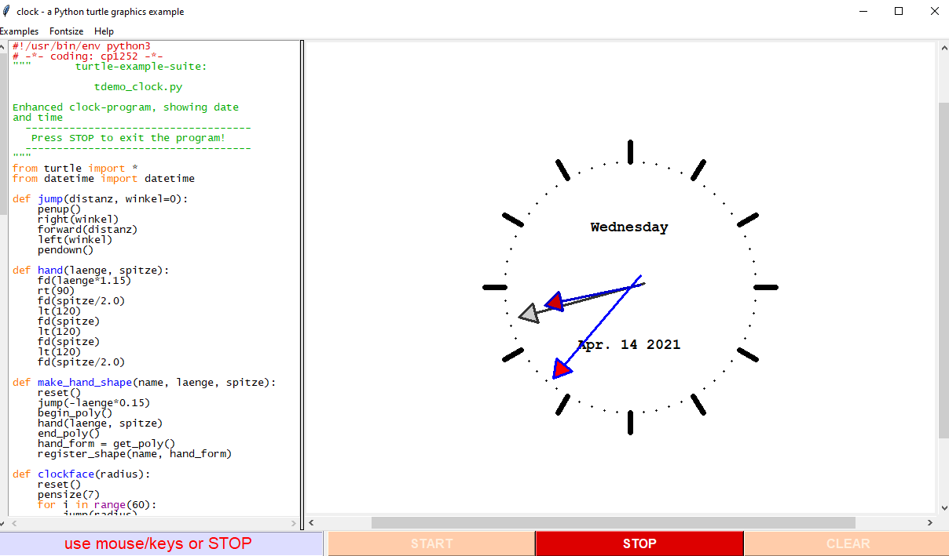

Slide 6
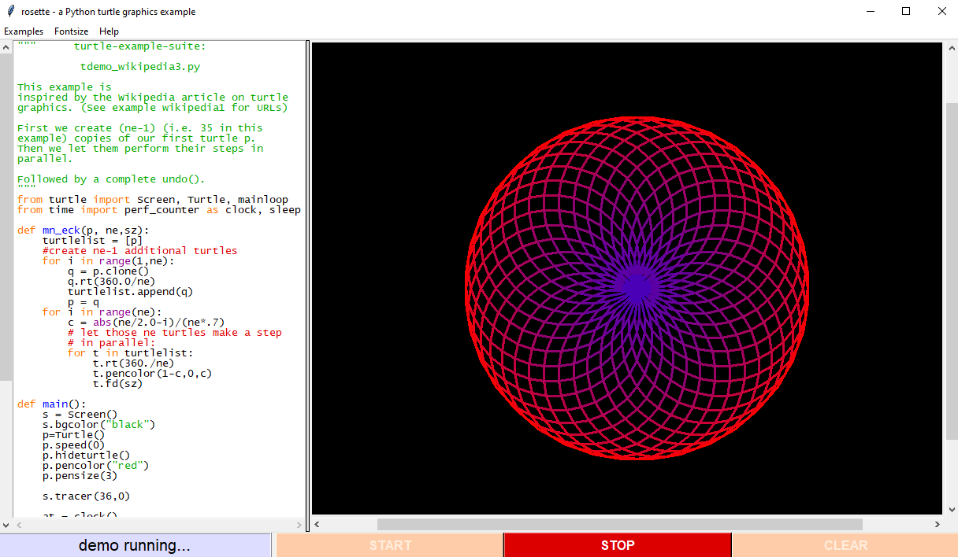

Slide 7
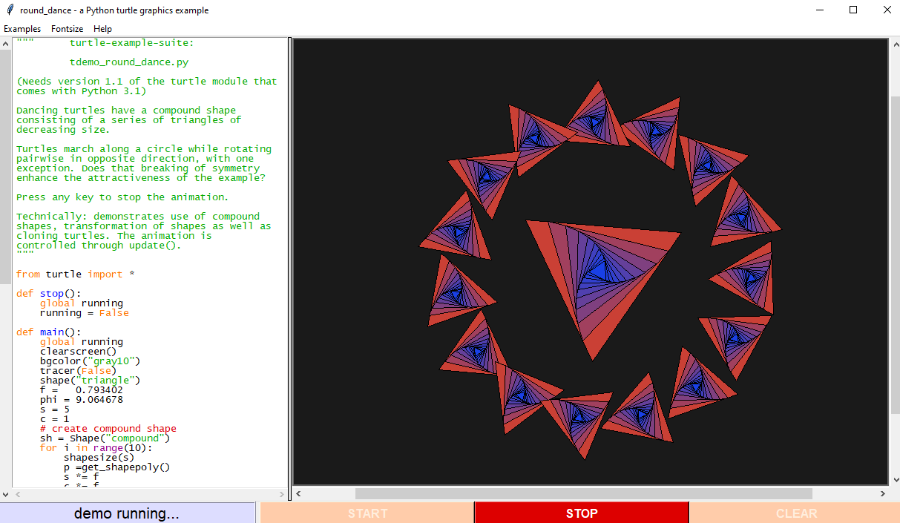

Slide 8
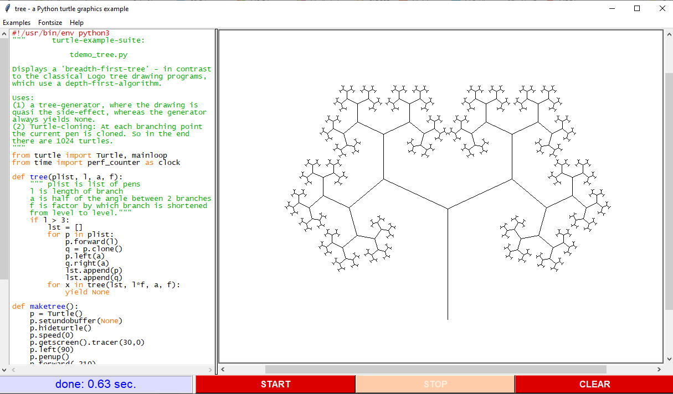

Slide 9
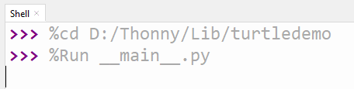
Poskusimo

Slide 10
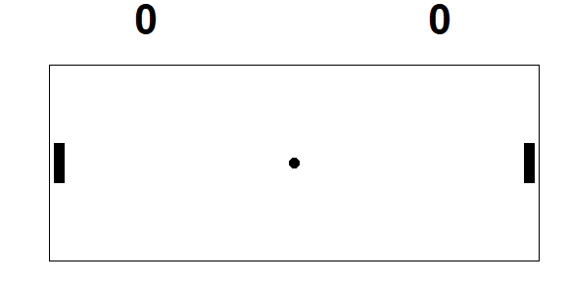
Igre z želvjo grafiko
https://learn.wecode24.com/pong-with-turtle-graphics-part-1/
https://codereview.stackexchange.com/questions/200782/python-turtle-based-pong-game
https://blog.eduonix.com/software-development/learn-create-python-snake-game-using-python-ide/
https://www.youtube.com/watch?v=oS44utZ1uqg

