Slide 1
Uporaba (vgrajenih) knjižnic …

Slide 2
https://projecteuler.net/problem=25
The Fibonacci sequence is defined by the recurrence relation:
F_{n} = F_{n−1} + F_{n−2}, where F₁ = 1 and F₂ = 1.
Hence the first 12 terms will be:
F₁ = 1
F₂ = 1
F₃ = 2
F₄ = 3
F₅ = 5
F₆ = 8
F₇ = 13
F₈ = 21
F₉ = 34
F₁₀ = 55
F₁₁ = 89
F₁₂ = 144
The 12th term, F₁₂, is the first term to contain three digits. What is the index of the first term in the Fibonacci sequence to contain 1000 digits?

Slide 3
namespace Euler_25
{
class Program
{
static void Main(string[] args)
{
int l1 = 1;
int l2 = 1;
int current = l1 + l2;
while (current.ToString().Length < 1000)
{
l2 = l1;
l1 = current;
current = l1 + l2;
}
Console.WriteLine(current);
}
}
}

Slide 4
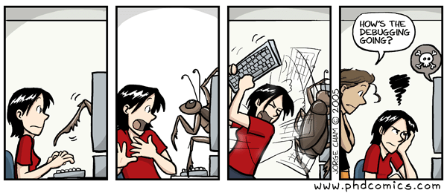
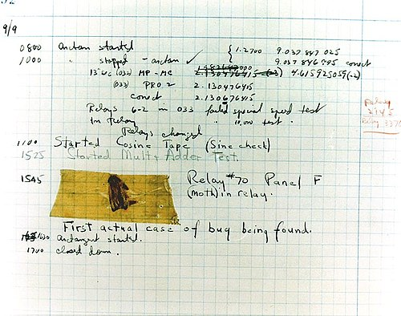

Nič se ne zgodi?

Slide 5
https://docs.microsoft.com/en-us/visualstudio/debugger/getting-started-with-the-debugger?view=vs-2019

Slide 6
using System;
using System.Numerics;
namespace Euler_25
{
class Program
{
static void Main(string[] args)
{
BigInteger l1 = 1;
BigInteger l2 = 1;
BigInteger current = l1 + l2;
while (current.ToString().Length < 1000)
{
l2 = l1;
l1 = current;
current = l1 + l2;
}
Console.WriteLine(current);
}
}
}

Slide 7
