Slide 1


P vs. NP

Slide 2
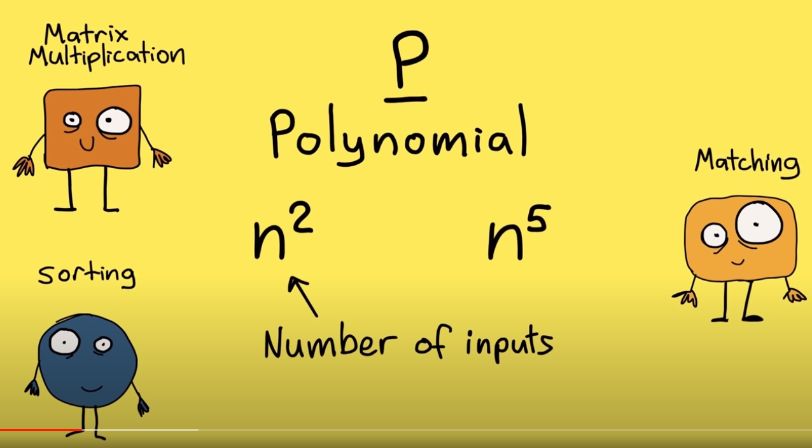

Slide 3
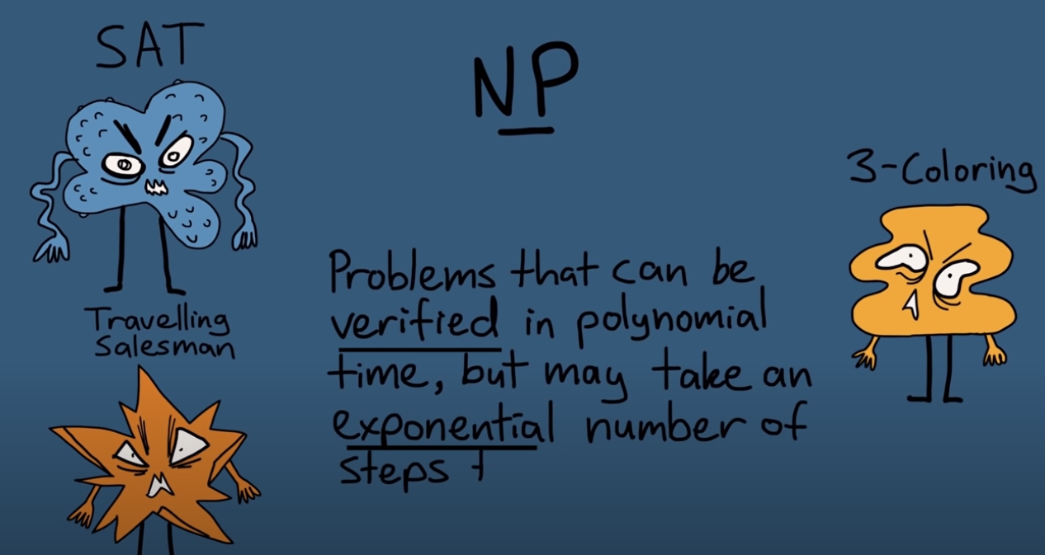

Slide 4
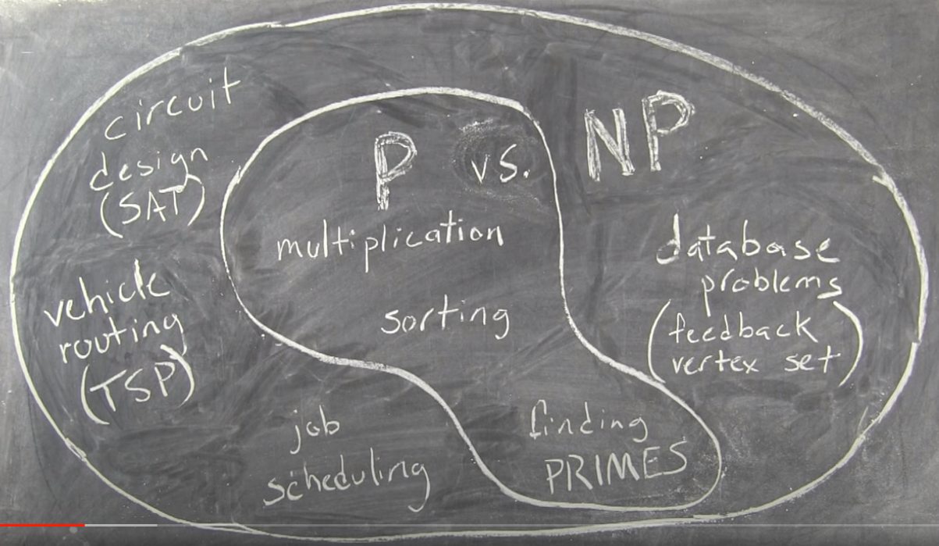

Slide 5
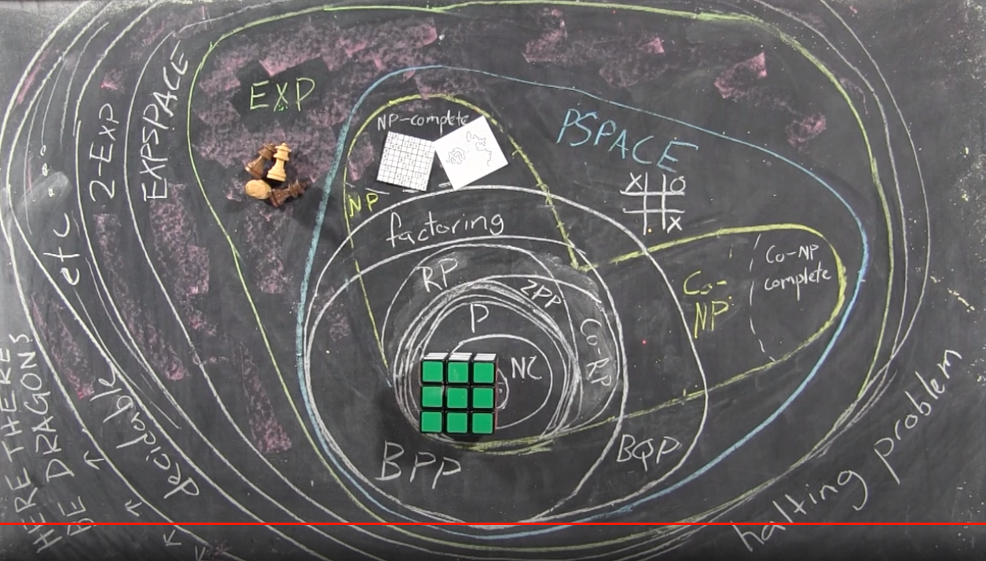

Slide 6
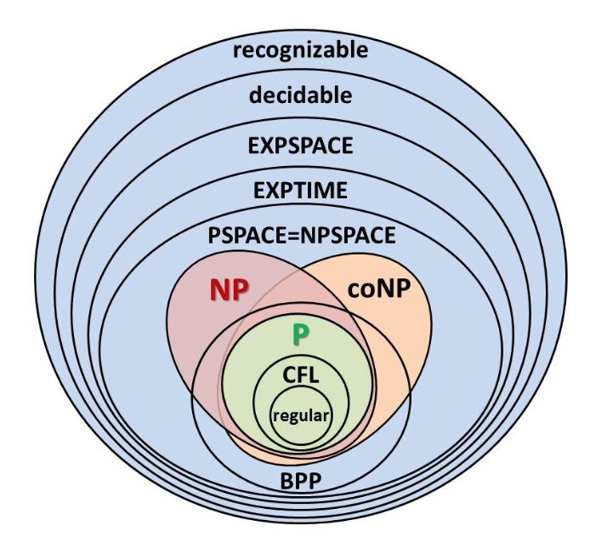

Slide 7


Povezave
P vs. NP and the Computational Complexity Zoo
P vs. NP - An Introduction
P vs. NP - The Biggest Unsolved Problem in Computer Science
Lecture 23: Computational Complexity
P vs NP on TV – Computerphile
What is complexity theory? (P vs. NP explained visually)
The Formal Definition of P (P vs NP)
What Computers Can't Do - with Kevin Buzzard
Donald Knuth: P=NP | AI

