Slide 1

OSNOVE UNITY
Amadej Gruden
PrM 3. letnik

Slide 2
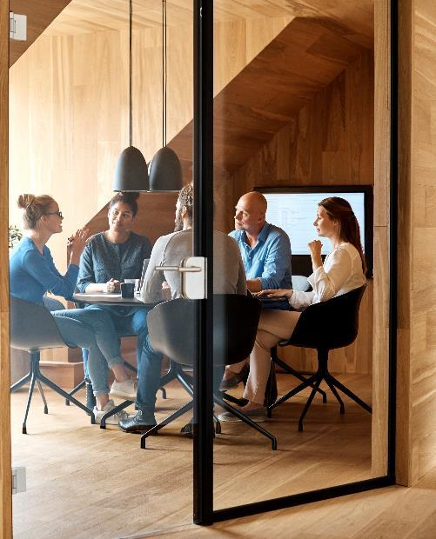



Kako je nastal?
2002 Copenhagen Nicholas Francis
2005 6. junij
Pokemon Go

Slide 3

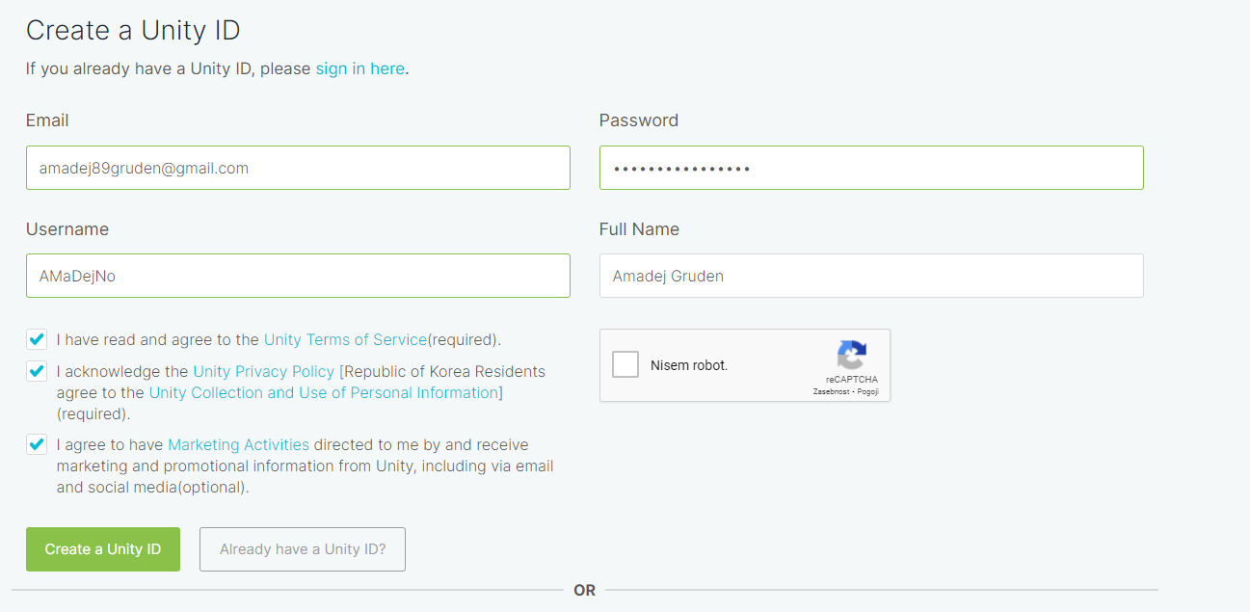
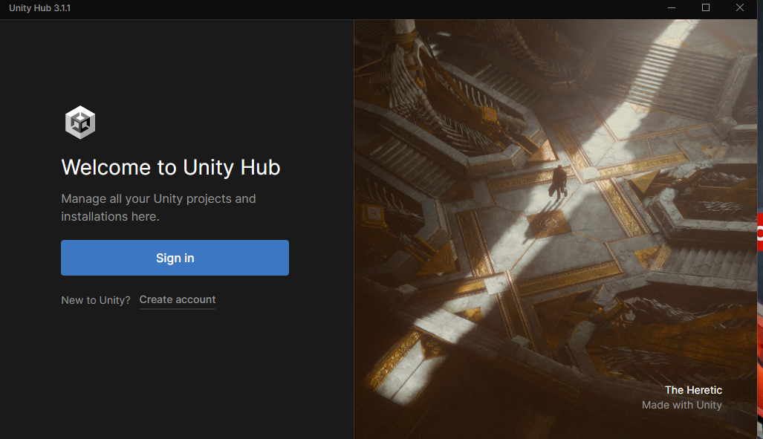
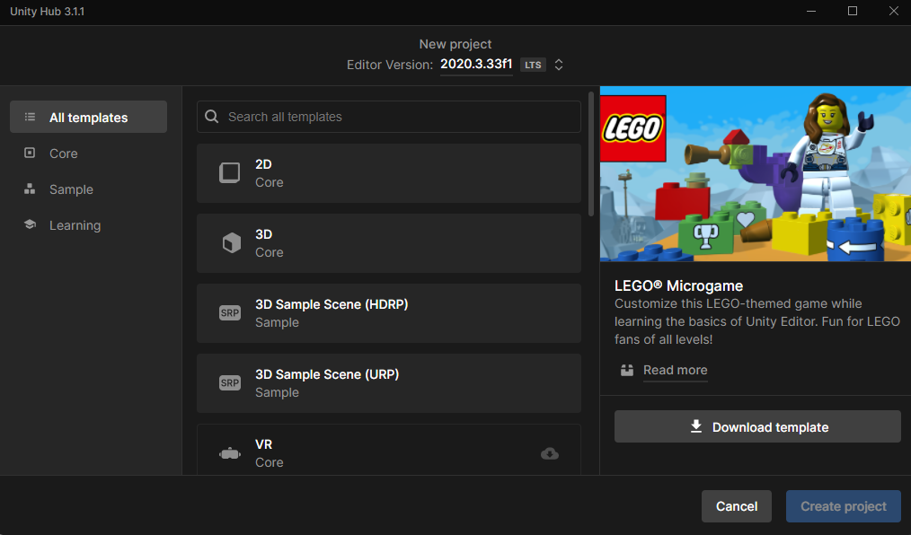

Slide 4
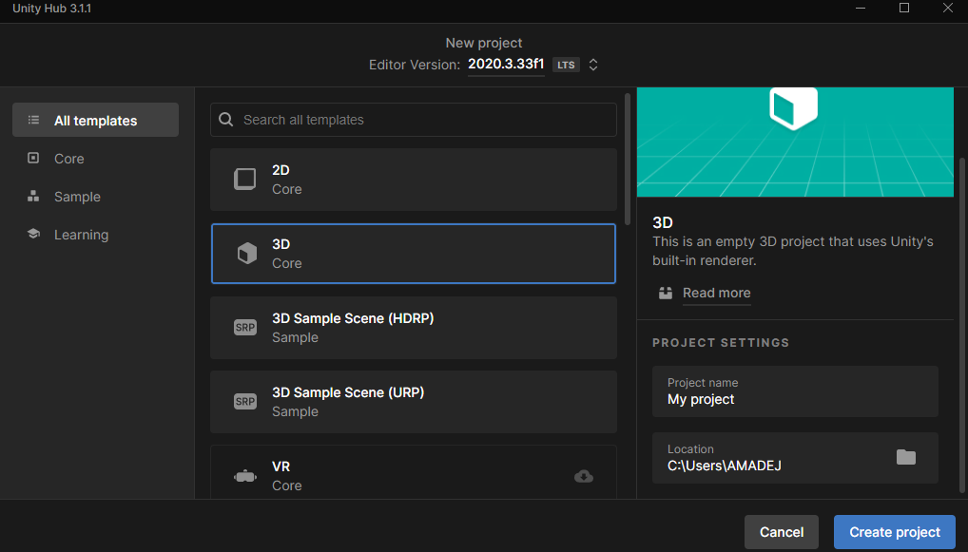

Slide 5
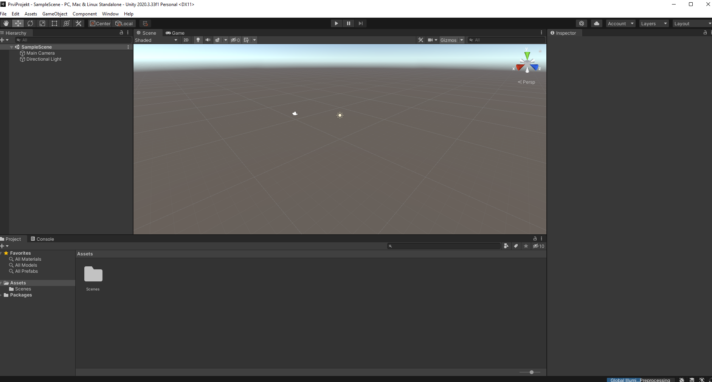

Slide 6
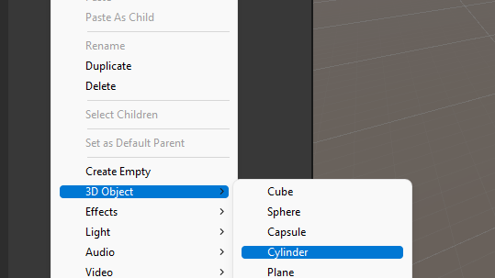
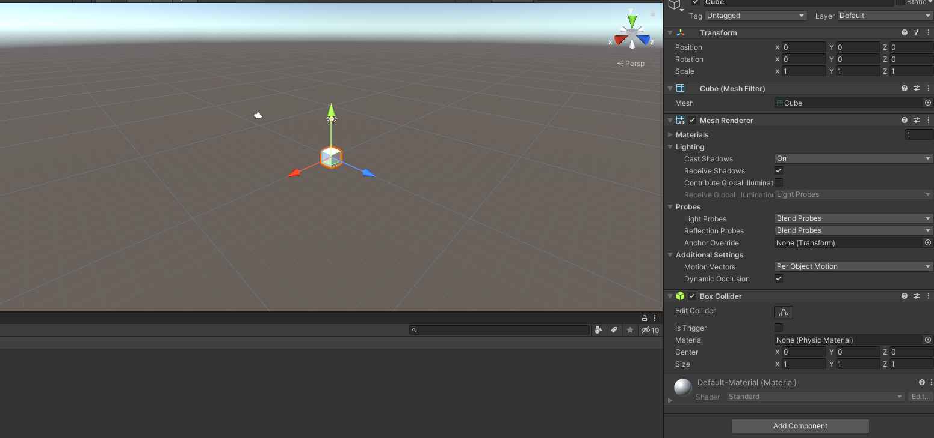

Slide 7
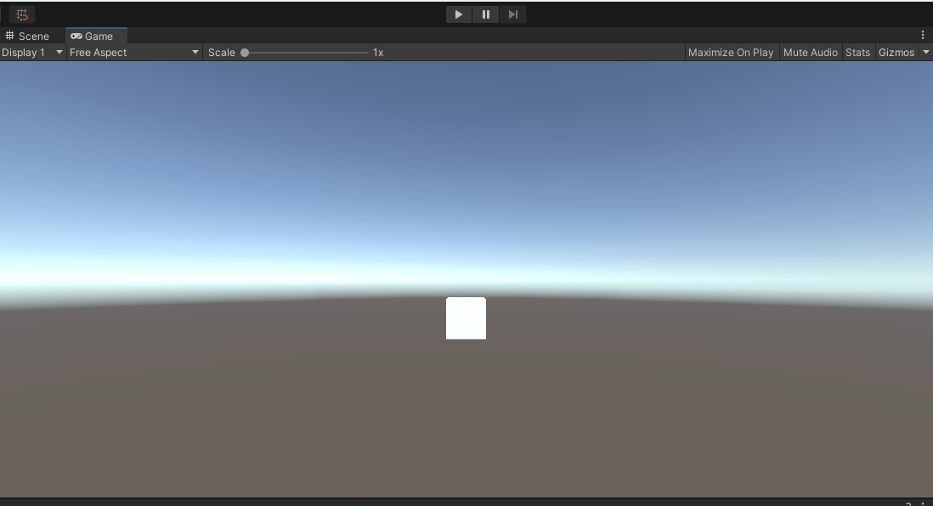

Slide 8
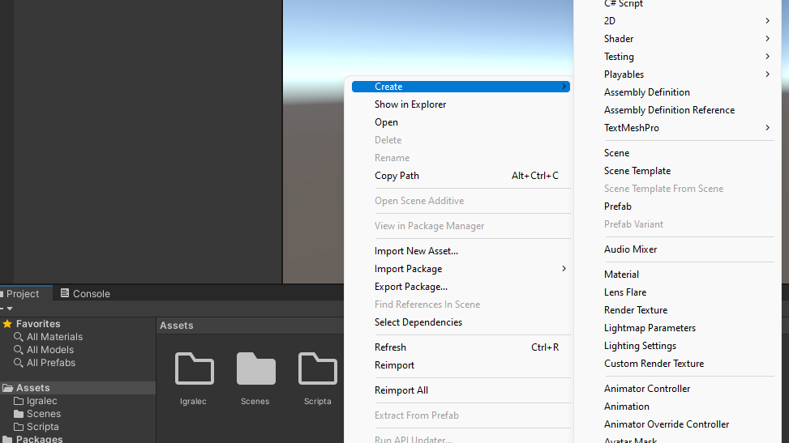

Slide 9
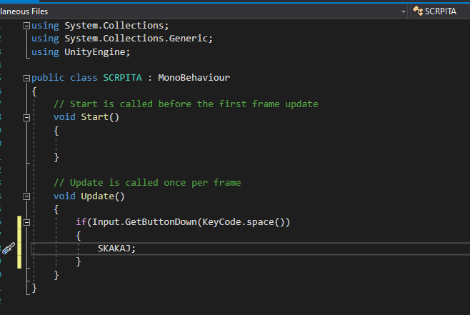

The way to get started is to quit talking and begin doing.
Walt Disney

Slide 10


Hvala za pozornost
VPRAŠANJA?

Slide 11

viri
https://en.wikipedia.org/wiki/Unity_(game_engine) (10.4.2022)

